Slide 1
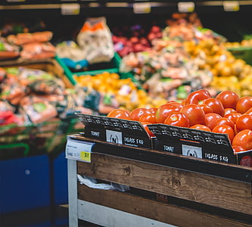
Predicting Changes in Food Prices to
Provide Meal Recommendations
Jordyn Dolly & Jada Cuthbertson
DSBA 6156 Fall 2023

Slide 2

Our Data
“Average Price Data” from the Consumer Price Index (CPI) - US Bureau of Labor Statistics
Shows the monthly average price per unit of an item. Data is available as far back as 1980 but for the purpose of this project we compile data from 2000 until 2023
286 Observations between January 2000 and September 2023
Issues: missing data, large price increases in small time periods
Using the “Average Price Data” dataset, we computed monthly price movement for each individual item (ie ‘MPM Eggs’) and Total Price Movement (TPM) across all items for each month
TPM was converted into a binary variable
1 indicates an increase in price
0 indicates no change or a decrease in price
Created a dataset that contains dishes and the various ingredients used to make that dish to try to provide recommendations of meals based on the ingredients inserted

Slide 3
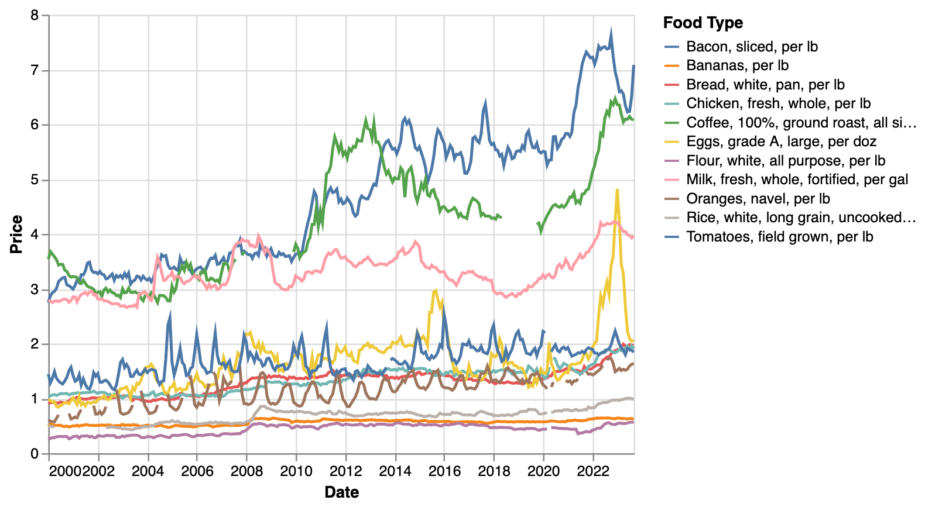
“Average Price Data” From CPI
Notes:
Exploratory data analysis / modeling

Slide 4
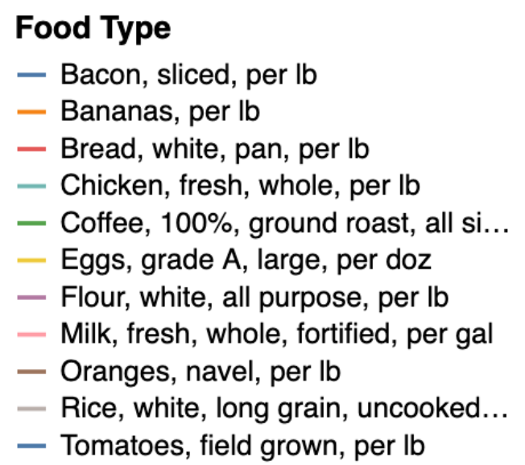
Price Changes of Food Products Over Time
Practically in this model we cannot predict life events like the Avian Flu, severe droughts or other scenarios that would result in an unusually low supply
We suspect that most of the increases in price are due to inflation
Bananas remained the most consistent in price, likely due to a significant portion of the bananas in the US being imported
Coffee, Oranges, and Rice all had over 25 missing values so we decided to drop these variables as replacing the values would drastically impact the price movement calculations

Slide 5
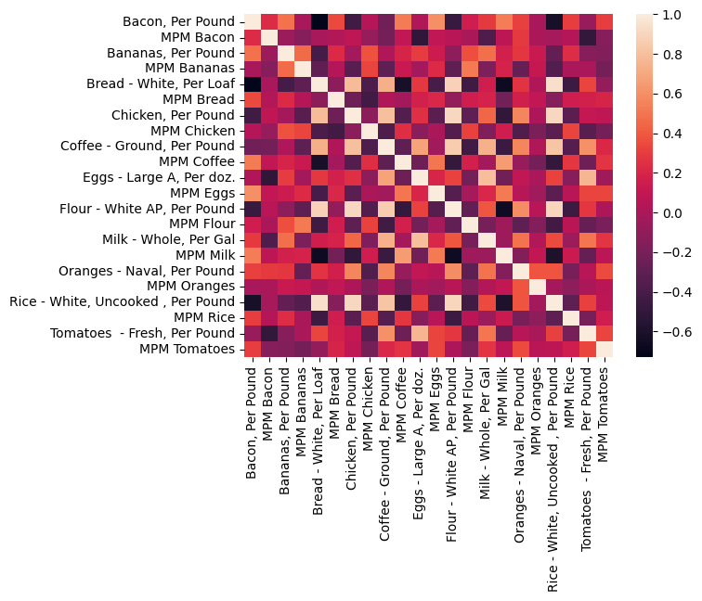
Correlations in Price Changes within the Data
Within the data set there are very few strong correlations. Most of the correlations within products fall within the medium to weak level
Grains and grain products appear to show a strong positive correlation to each other
Flour and Bread
Rice and Bread
There is also a strong positive correlation in products that we think are frequently purchased together.
Chicken and Rice
A handful of moderate negative correlations can be noted
Bread and Bacon, Flour and Bacon, Rice and Bacon

Slide 6
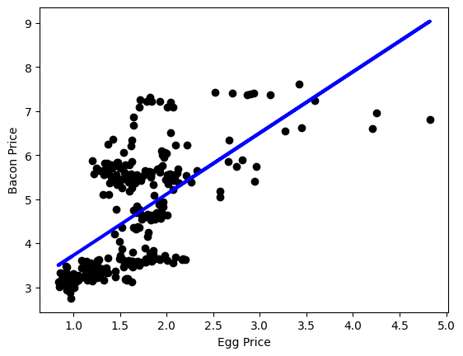
Regression Analysis
From the correlation matrix we were able to determine that eggs and bacon were not directly correlated.
While the price of eggs obviously does not have a direct impact on the price of bacon, we are able to see that in general, as the price of one increase we do see an increase in the price of the other.
It appears that the price of bacon has not exceeded $8.00 per pound, which is likely a result of price elasticity based on demand.
Price elasticity of demand is the ratio of the percentage change in quantity demanded of a product to the percentage change in price.
We can generally predict that if we are going to see an increase in the price of eggs, there will likely be a price increase in bacon as well.

Slide 7
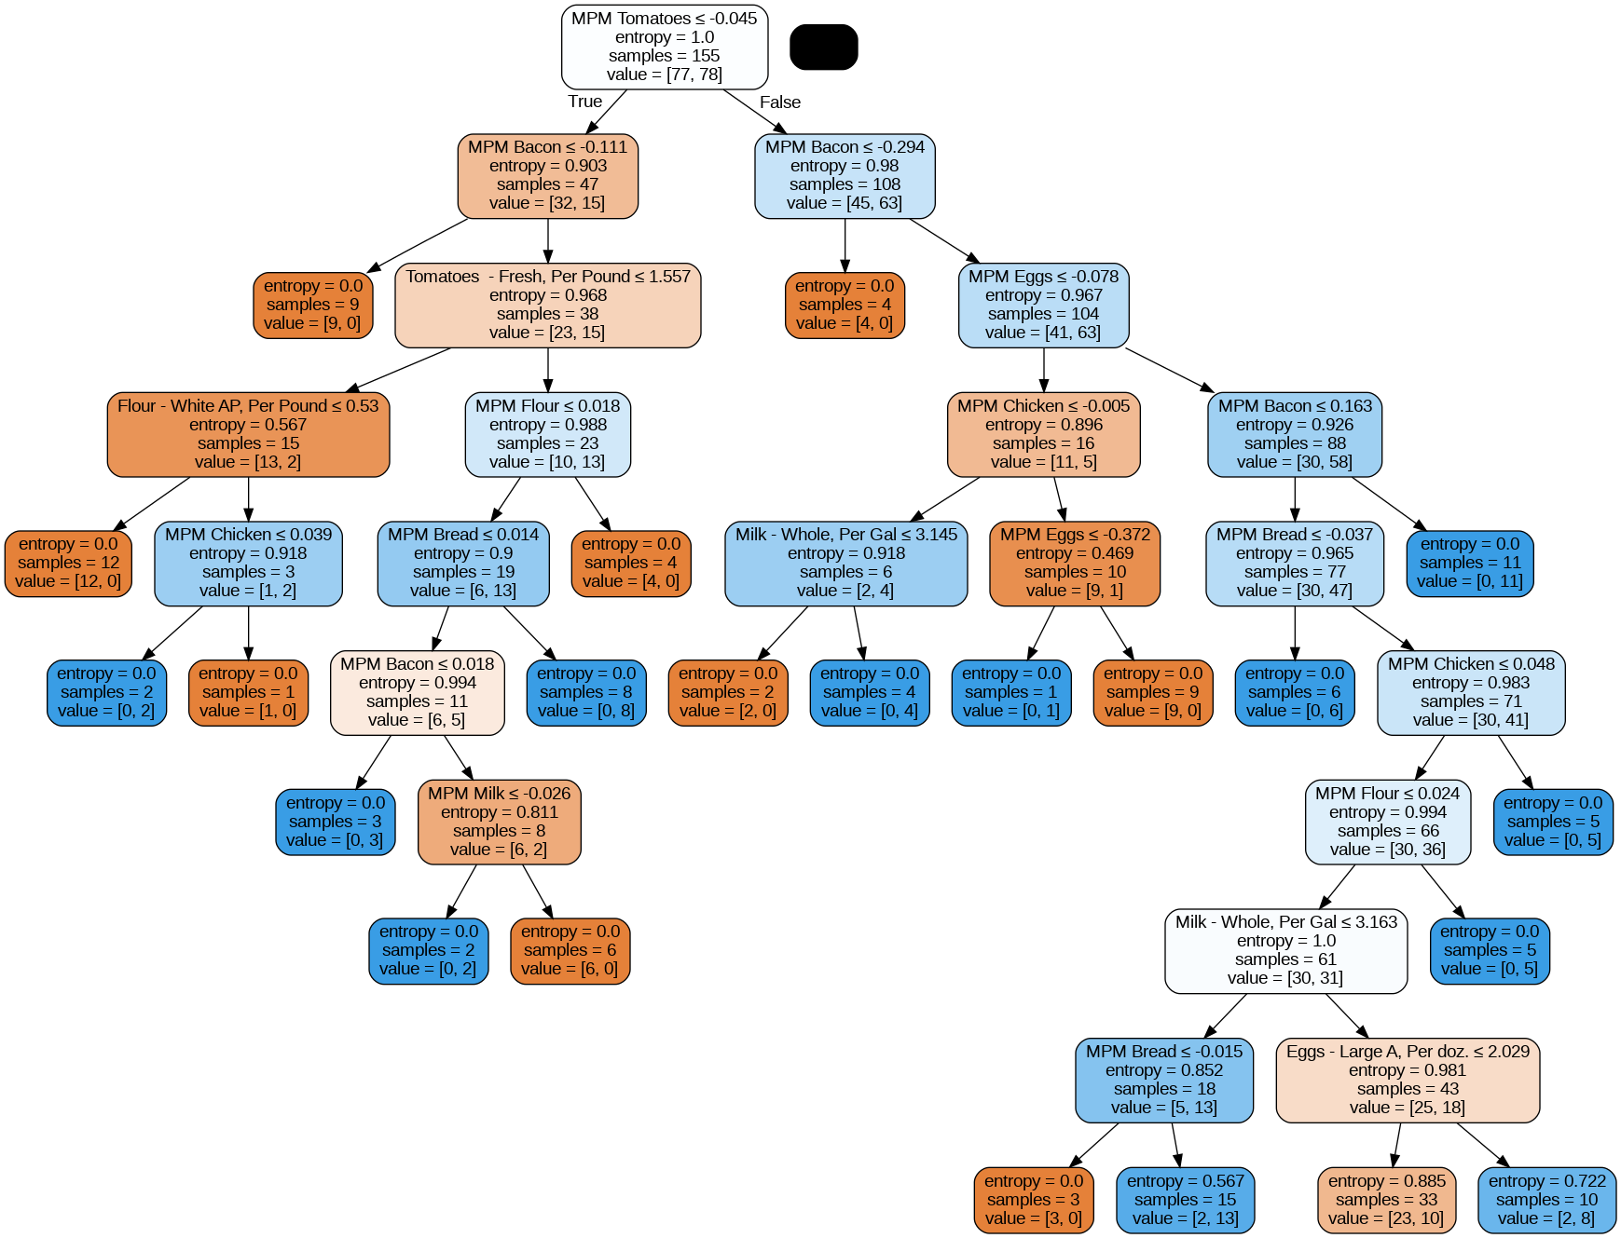
Decision Tree
To break down the complexity of each of the ingredients and their monthly price movement (MPM) we started with a decision tree
Goal: determine if there
1 = price increase
0 = no change/decrease in price
Initial Accuracy of 0.46153846
Grid Search Optimized Tree: Accuracy of 0.667
Looking at the final leaves in the optimized tree, in 12 paths we see an overall decrease or no change across all food items, and 10 paths in which there is a consistent increase from month to month

Slide 8
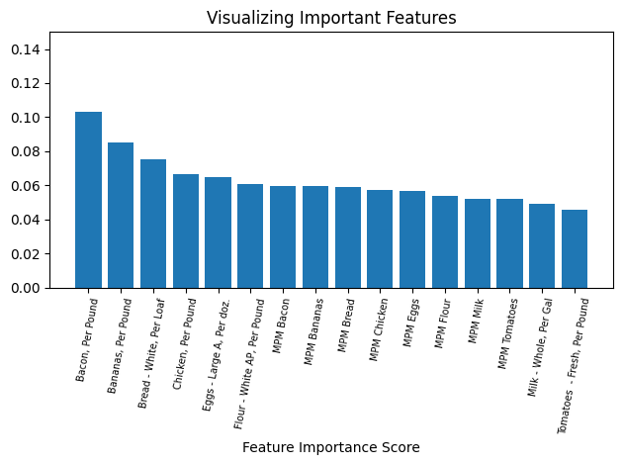
Random Forest Model
With the decision tree model still having a relatively low accuracy score, a random forest model was then implemented
With 100 trees in the forest we reached an accuracy score of 0.7435897
When running a prediction test with 16 features our result was 1. Indicating that it is likely for there to be a general increase in the price of these food items next month
With a relatively small range within the most important features
Bacon was found to be the most important feature with a score of 0.103387
Difference of 0.03 between the top 3 most important features
Tomatoes was the least important at 0.045655

Slide 9
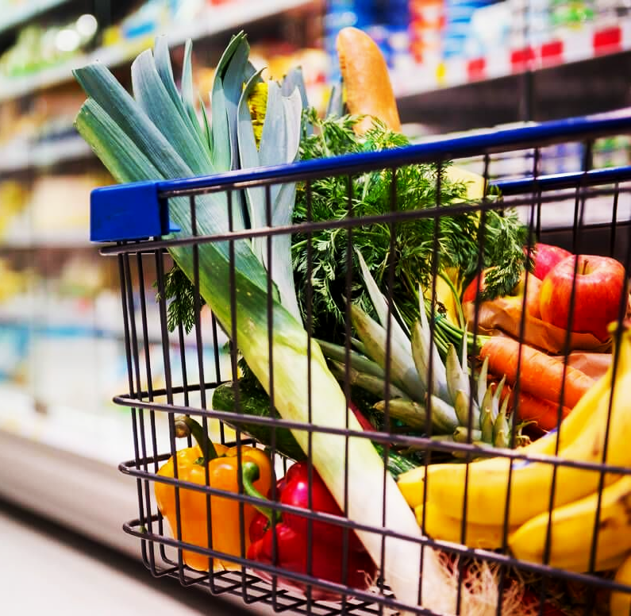



AdaBoost Model
Summary
Pulling the top 5 most important features from the Random Forest model, we applied them into an AdaBoost model
The AdaBoost model had the lowest accuracy score of 0.457627
Since this type of model can be sensitive to data noise , the model tried too hard to fit the sudden increases and decreases in prices
Decision Tree Accuracy | Random Forest Accuracy | AdaBoost Accuracy
Tree became extremely overfit as we pruned leaves | Most Accurate | The use of the most important features and noisy data made the model sensitive

Slide 10
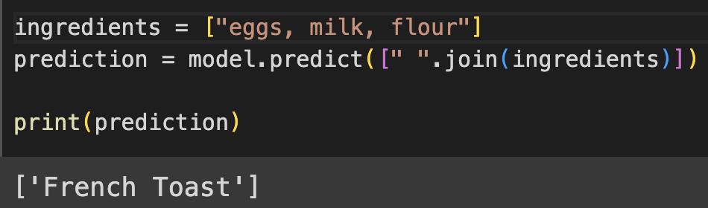

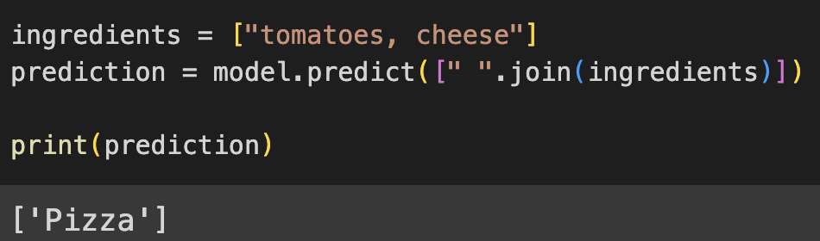

Text Classification to Create Food Recommendations
By compiling a dataset of various foods and the ingredients used to make them, we created a simple text classification model to predict dishes
Inserting one ingredient or multiple ingredients into the ingredients line allows the Naive Bayes classifier to recommend a food to make
The small dataset that we had created made a Naive Bayes classifier the most appropriate option
To create a more complex model, our next step would have been to compile images of the ingredients and the dishes they are made into to predict food suggestions

Slide 11
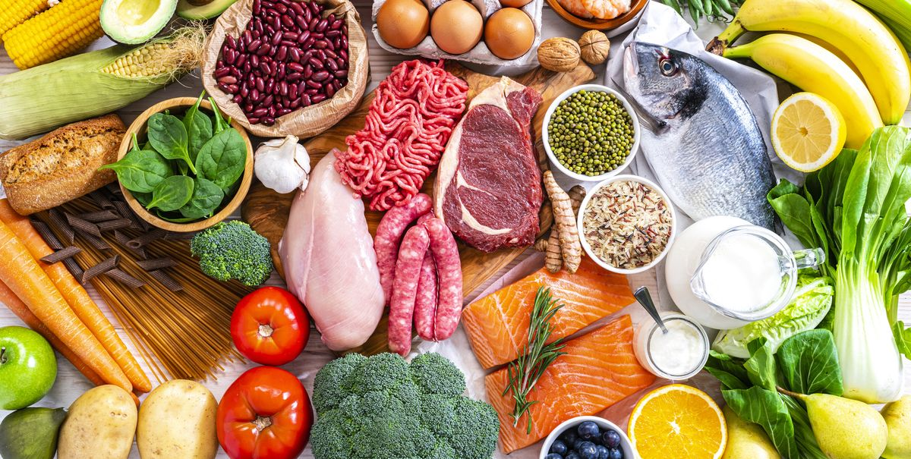
Questions?

